Slide 1
Lecture 6e: Main Control Design
To watch lecture video click link below
Lecture 6e video
To view slides, continue to next slide

Slide 2
Lecture 6e: Main Control Design

Slide 3
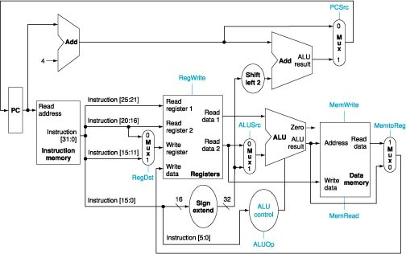
Control Signals on Datapath

Slide 4
Concurrent Behavior of Hardware Units
For any instruction execution, all hardware units are functioning.
However, the results of some units are blocked by some controls.
For example, if the instruction in execution is lw, the result of adder (connected to shift left 2 unit) is blocked by PCSrc (for lw, PCSrc is 0).

Slide 5
What Control Signals needed for the datapath?
RegWrite: controls the write action to the registers
MemRead and MemWrite: control the read and write actions to the DM
Each MUX needs a control signal as selector
It selects one and only one input to go through;
It could be x (don’t care) if output not used.
We give each a meaningful name, e.g.
RegDst to select the rd (3rd in instruction for R-type, 2nd for lw)
ALUSrc to select ALU’s 2nd operands (i.e. ReadData2 or immediate.)
ALUOp (2-bit) as we discussed in ALU control
No control signals needed for IM, PC as we explained in Lecture 6a

Slide 6
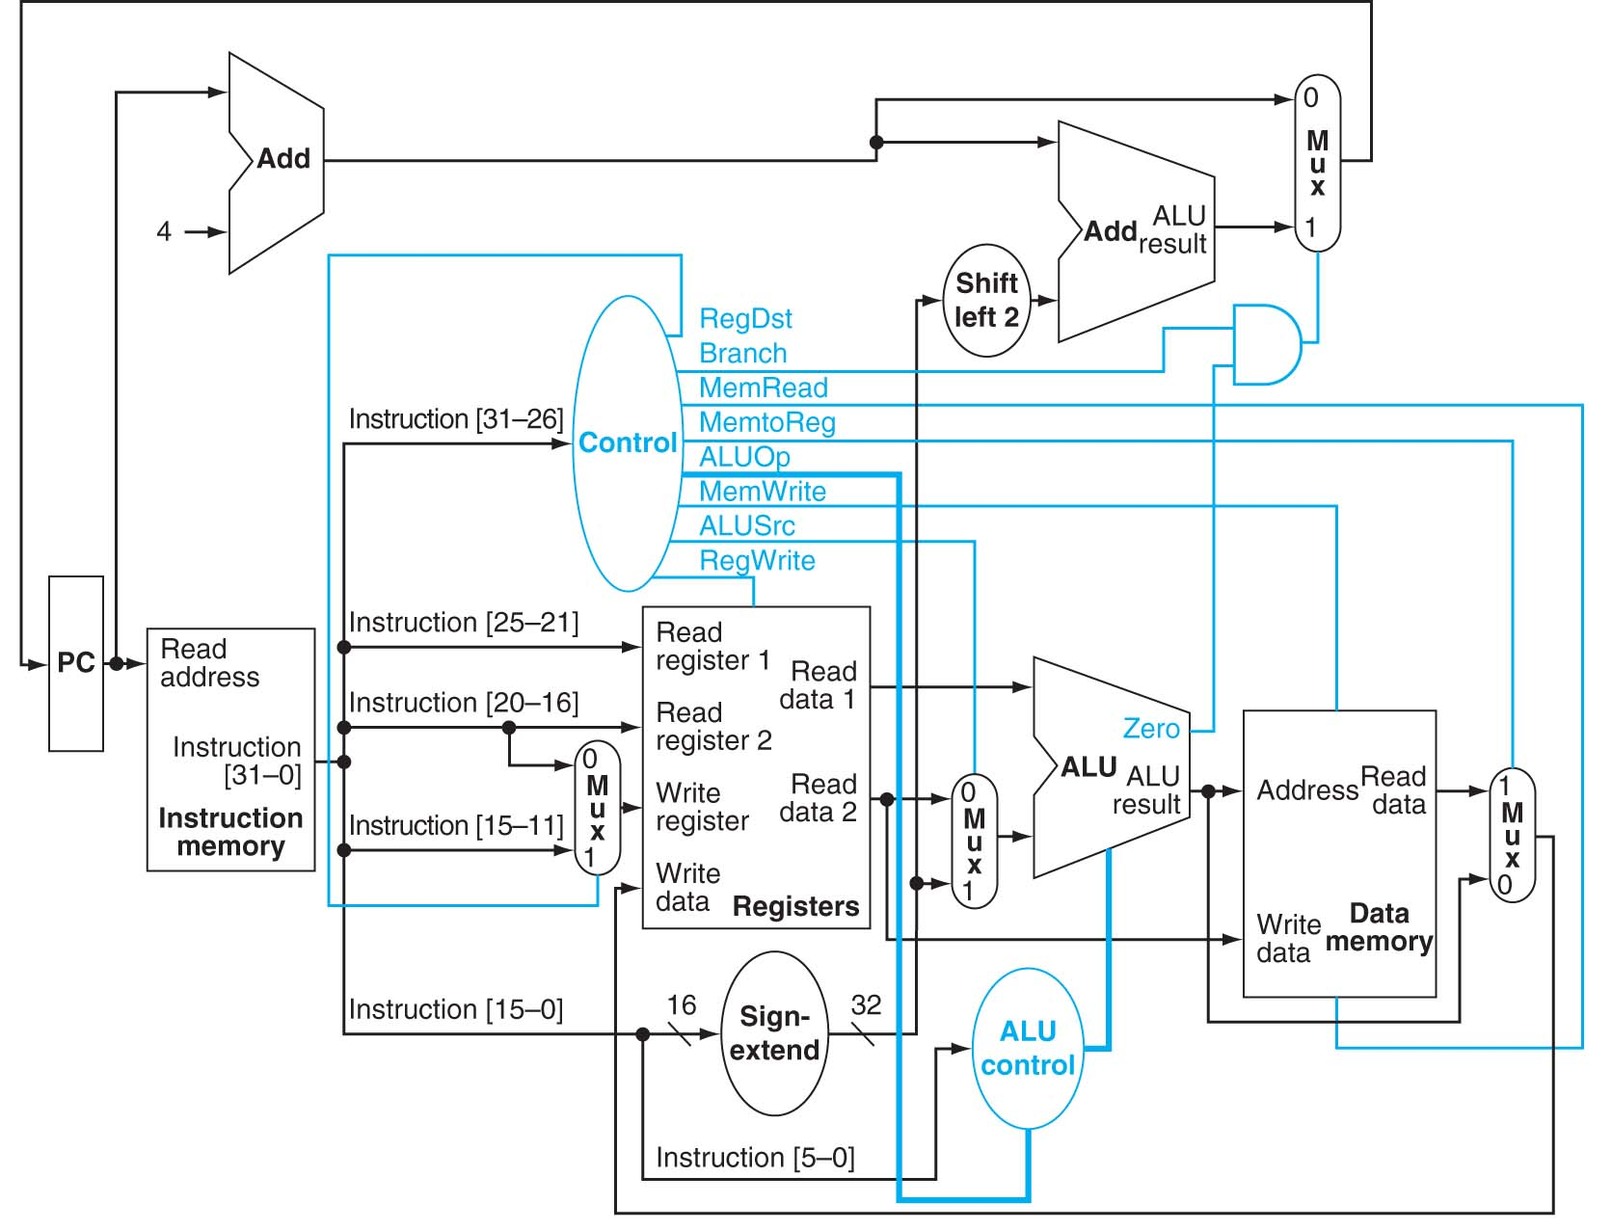
Main Control Unit

Slide 7
Abstraction of Main Control Unit
The input to the main control:
6-bit opcode
(from opcode we know which instruction it is, for that instruction we know which datapath it takes, thus we know all the control signals for that instruction.)
Input to main control
Output of the main control:
all the signals for the datapath
(ALUOp is a 2-bit signal while others all 1-bit signal.)
Outputs of main control

Slide 8
Determining Control Values
Selecting the operations to perform (ALU, read/write, etc.)
Controlling the flow of data (multiplexor inputs)
Information comes from the 32 bits of the instruction
Example: add R8, R17, R18 Instruction Format: R 000000 10001 10010 01000 00000 100000 op rs rt rd shamt funct
ALUOp: 10 (from Lecture 6d) RegWrite: 1 (write back to rd)
MemRead: 0 MemWrite: 0 (no memory action)
Branch: 0 (not a beq instruction)
note: PCSrc = Brand and Zero (i.e. jump only if branch instruction and equal.)
Other signals: determined by datapath

Slide 9
Controlling MUX for R-type Instructions
RegDst: 1
ALUSrc: 0
MemtoReg: 0

Slide 10
Strategies in Designing the Main Control
Background
How ALUOp generated?
How MUXs controlled?
When and how to set memory read and write signals?
When and how to set registers read signal?
Control signals
RegDst, RegWrite, ALUSrc, ALUOp, MemWrite, MemRead, MemToReg, PCSrc
From the instruction’s opcode, all the above signals but one (PCSrc) can be generated
PCSrc needs the result of ALU comparison (zero) and a control signal Branch control signal: PCSrc=zero and Branch

Slide 11
Strategies: Role of the Control Signals
RegDst
For R-type instructions, such as add R12, R15, R16, Instruction[15-11], i.e. the 3rd register number (i.e. rd) should be used to write the register file. So, RegDst should be set to 1.
For lw, such as lw R12, 0x0100(R15), Instruction[20-16], i.e. the 2nd register number should be used to write the register file. So, RegDst should be set to 0.
ALUSrc
For R-type and beq instructions, the 2nd register read should be fed to ALU, so ALUSrc should be set to 0.
For lw and sw, the offset with sign extension should be fed to ALU, so ALUSrc should be set to 1.
Similar analysis for other signals

Slide 12
Strategies: Instructions => Control Signal Values
Tracing each instruction’s datapath => get the control values
We’ve given R-type instruction example
We’ll give one more example: lw
Practice: do the same for sw and beq
Once figure out controls values for each instruction => construct a truth table

Slide 13
Control Values for lw
From datapath:
RegDst: 0 ALUSrc: 1
MemtoReg: 1
From instruction itself:
Branch: 0, ALUOp: 00
From datapath or instruction:
RegWrite: 1, MemRead: 1
MemWrite: 0

Slide 14
Opcodes and the Control Signals: Truth Table
Note: from the highlighted datapath, if a MUX not marked, then the control signal could be X (don’t care).

Slide 15
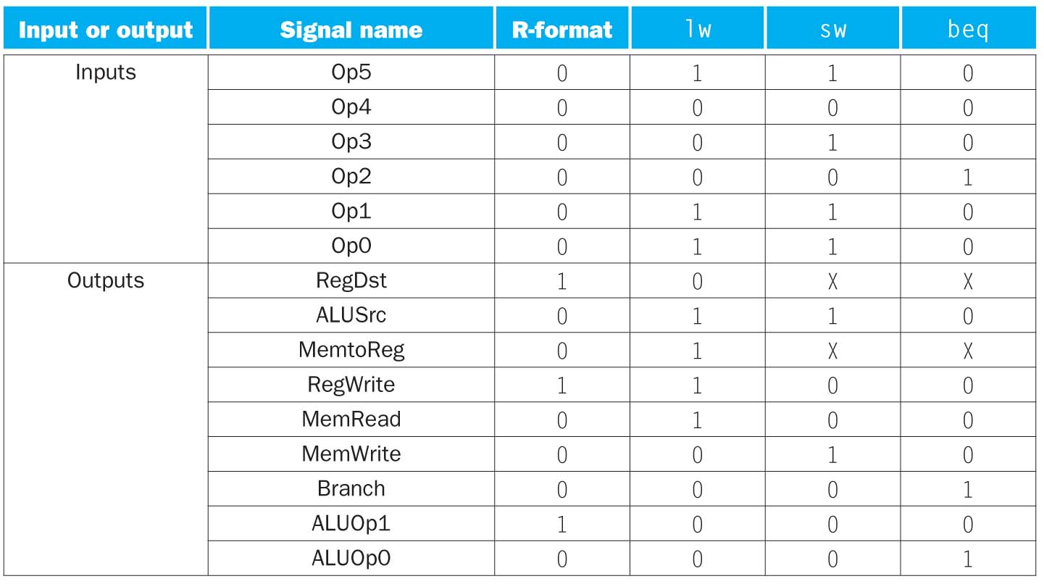
Truth Table of Control Unit
Note: you get this table by filling in the opcode value at the table shown in previous slide, then turn the table 90º.

Slide 16
Implementation of Control Signals
Note: implementation details not further discussed in this class.

Slide 17
Summary: The Simple Control Structure
All of the logic is combinational
Need to wait for everything to settle down, and the right thing to be done
ALU might not produce “right answer” right away
use write signals along with clock to determine when to write
Cycle time determined by length of the longest path
CPI = 1 (but a long cycle so clock rate must be very slow.)
Not good performance
Improvement: small but multiple cycles, and pipelined!

Slide 18
Practice
So far we have created a Simple Scheme that includes datapath and control for the implementation of a subset of MIPS instruction.
Now, we’d include the following instructions on the datapath, what changes, if any, you’d make to the datapath as well as control unit(s)? Add each instruction independently.
addi
ori
bne

